Slide 1
FUNCTIONS
Sagar Giri

Slide 2
SQL User-Defined Functions
Functions in programming languages are subroutines used to encapsulate frequently performed logic.
Any code that must perform the logic incorporated in a function can call the function rather than having to repeat all of the function logic.

Slide 3
Types:
Built-in functions
User-defined functions
  User-defined functions take zero or more input parameters, and return a single value. Some user-defined functions return a single, scalar data value, such as an int, char, or decimal value.

Slide 4
Creating a Function
A standalone function is created using the
CREAT E FUNCT ION statement.

Slide 5
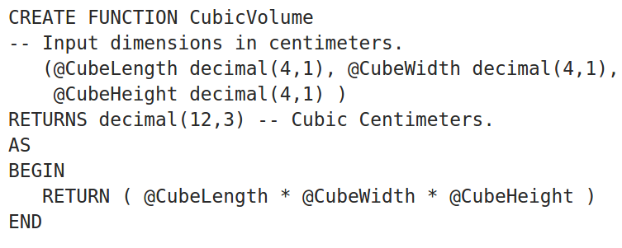

Slide 6
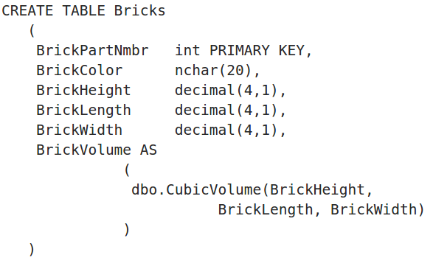

Slide 7
SQL Server 2000 also supports user-defined functions that return a table data type:
A function can declare an internal table variable, insert rows into the variable, and then return the variable as its return value.
A class of user-defined functions known as in-line functions, return the result set of a SELECT statement as a variable of type table.

Slide 8
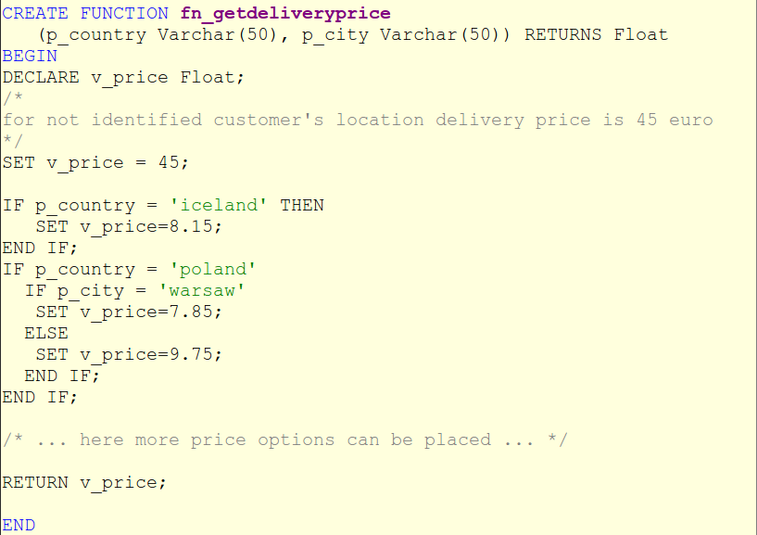
In MySQL

Slide 9
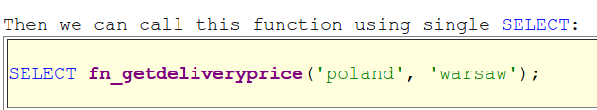
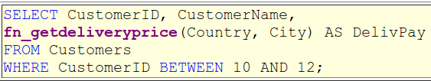
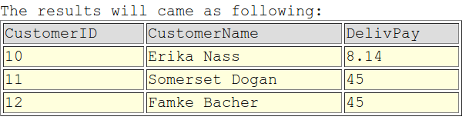
Or call function for every row in SELECT statement:

Slide 10
Benefits of User­Defined Functions?
we can use these functions in so many different places when compared to the SQL Server stored procedure.
The ability for a function to act like a table (for Inline table and Multi-statement table functions) gives developers the ability to break out complex logic into shorter and shorter code blocks.
Gives additional benefit of making the code less complex and easier to write and maintain.
In the case of a Scalar User-Defined Function, the ability to use this function anywhere you can use a scalar of the same data type is also a very powerful thing.

Slide 11
Conclusion:
Combining these advantages with the ability to pass parameters into these database objects makes the SQL Server User-Defined function a very powerful tool.

Slide 12
THANK YOU!

